Slide 1
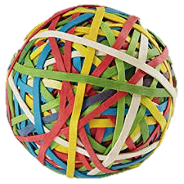
Elasticity
Of Supply and Demand

Slide 2
What is elasticity?
Elasticity is how economists describe consumer reaction to price changes.
If consumers react heavily to a small price change, their demand is elastic.
Like a rubber band
If consumers only react slightly to a large price change, their demand is inelastic.
Like a paper clip

Slide 3
Examples of Elasticity
What would happen if Pepsi decides to double the price of their soda? Why?
Sales will decrease dramatically as consumers switch to Coke.
In this case, demand is Elastic.
What if the price of gasoline doubles?
Sales will go on relatively unchanged because people still need gas for their cars regardless of price.
In this case, demand is Inelastic.

Slide 4
How to calculate elasticity
Step 1: Calculate Percent Change in Price
Step 2: Calculate Percent Change in Quantity Demanded
Step 3: Calculate Elasticity
(original price) - (new price) .
original price
X 100
(original quantity demanded) – (new quantity demanded) .
original quantity demanded
X 100
Percent change in Quantity Demanded .
Percent change in price
= ELASTICITY
Notes:
DON’T WORRY ABOUT NEGATIVE NUMBERS! TAKE ABSOLUTE VALUE!

Slide 5
What do the numbers mean?
Once you determine your elasticity coefficient, the following chart describes your degree of elasticity:
Outcome | Elasticity
0 | Perfectly Inelastic
<1 | Relatively Inelastic
1 | Unit Elastic
>1 | Relatively Elastic
∞ | Perfectly Elastic

Slide 6
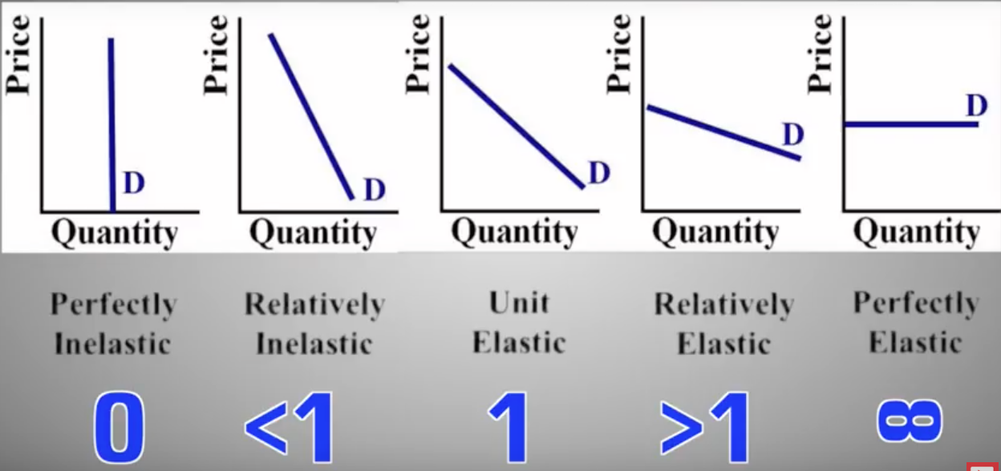
Graphs of elasticity

Slide 7
What impacts elasticity?
There are 4 factors that impact elasticity:
Availability of Substitutes- If there are a wide variety of alternatives, consumers will not buy a product when its price increases. Additionally, if there are not many substitutes, a consumer may still buy a product even if the price increases.
Relative Importance- If a product costs a high portion of your budget, you will respond more if the price increases. If a product does not take up much of your budget, you are less responsive to a change in price.

Slide 8
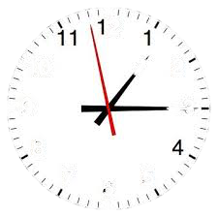
Impacts on Elasticity Cont’d.
Need Vs. Want- If a person considers a product to be a necessity, changes in price will not heavily impact their decision to buy. Conversely, if they consider the product to be a luxury item, they will be highly responsive to changes in price.
Change over Time- In the short term, consumers may not react to price changes. But as time goes on and people can find substitutes (or their preferences change) they may become more elastic.

Slide 9
Elasticity’s impact on revenue
Elasticity is important to businesses because it shows how price changes will impact their profit and total revenue.
When a products demand is Elastic consumers are more responsive to price change. Eventually, with enough of a price increase, total revenue will decrease.
$ Price of a slice of pizza | Quantity Demanded | Total Revenue
$1 | 300 | $300
$2 | 250 | $500
$3 | 200 | $600
$4 | 150 | $600
$5 | 100 | $500
$6 | 50 | $300

Slide 10
Elasticity’s Impact on revenue
When a products demand is Inelastic consumers are less responsive to a change in price. So as a business increases their price, they will also increase their total revenue. Additionally, if they decrease their price they will decrease their total revenue.
$ Price of Gas | Quantity Demanded | Total Revenue
$2.00 | 300 | $600
$2.50 | 280 | $700
$3.00 | 260 | $780
$3.50 | 240 | $840
$4.00 | 220 | $880
$4.50 | 200 | $900

Slide 11
Helpful hint
If you need to find Elasticity based on Price and Total Revenue, use this trick:
Price ⬆️, Total Revenue ⬆️ = Inelastic
Price ⬇️, Total Revenue ⬇️ = Inelastic
Price ⬆️, Total Revenue ⬇️ = Elastic
Price ⬇️, Total Revenue ⬆️ = Elastic
Notes:
Here I will show the students Clifford’s trick of making their bodies an “I” shape to determine elasticity.

Slide 12
Practice With a partner!
What Type of ELASTICITY AND Reasons Why This Good/ Service Has This Type of ELASTICITY
Scenario #1:
The price of cell phone data doubles from $50 to $100, and the quantity demanded decreases from 100gb to 85gb.
Scenario #2:
The price of Lay’s potato chips increases from $3 per bag to $5 per bag, and the quantity demanded decreases from 100 bags to 40 bags.

Slide 13
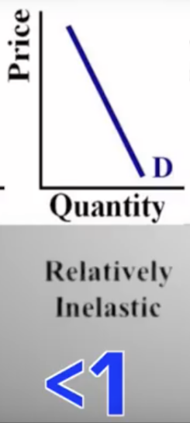
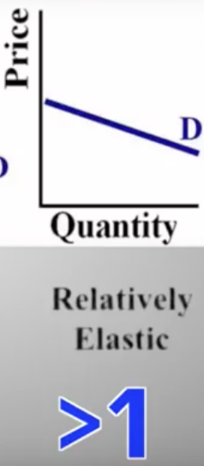
Scenario #1:
% Change in quantity demanded = 15%
% Change in price = 100%
Elasticity Coefficient? Type of Elasticity?
Scenario #2:
% Change in quantity demanded = 60%
% Change in price = 67%
Elasticity Coefficient? Type of Elasticity?

Slide 14
Scenario #3:
The price of girl scout cookies decreases from $5 to $4 per box, and the quantity demanded increases from 80 to 100 boxes.
Scenario #4:
The price of insulin increases from $50 to $100 per treatment, however the quantity demanded of insulin remains at 1,000 shots.
Scenario #5:
A farmer increases his price of corn from $1 to $1.10 per pound, however his quantity demanded decreases from 50 tons to 0 tons.

Slide 15
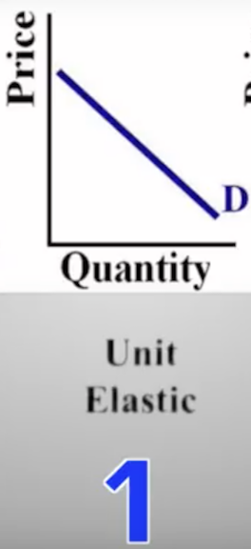
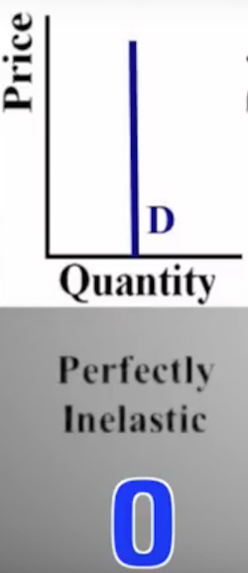
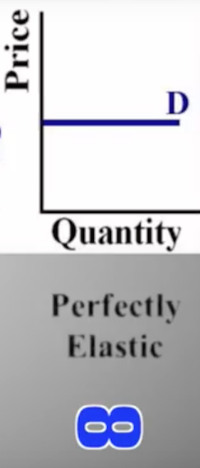
Scenario #3:
% Change in quantity demanded = 20%
% Change in price = 20%
Scenario #4:
% Change in quantity demanded = 0%
% Change in price = 100%
Scenario #5:
% Change in quantity demanded = 100%

